Slide 1
Machine Cycles & Bus Timing Diagrams
The total operations of a microprocessor can be classified into following four groups
Op-code Fetch
Memory Read & Write
I/O Read & Write
Request Acknowledge

Slide 2
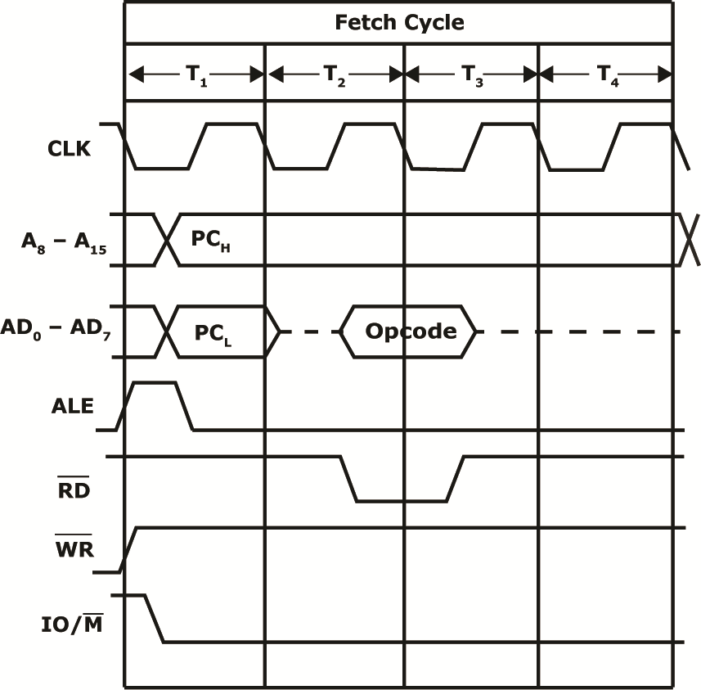
Machine Cycles & Bus Timing Diagrams

Slide 3
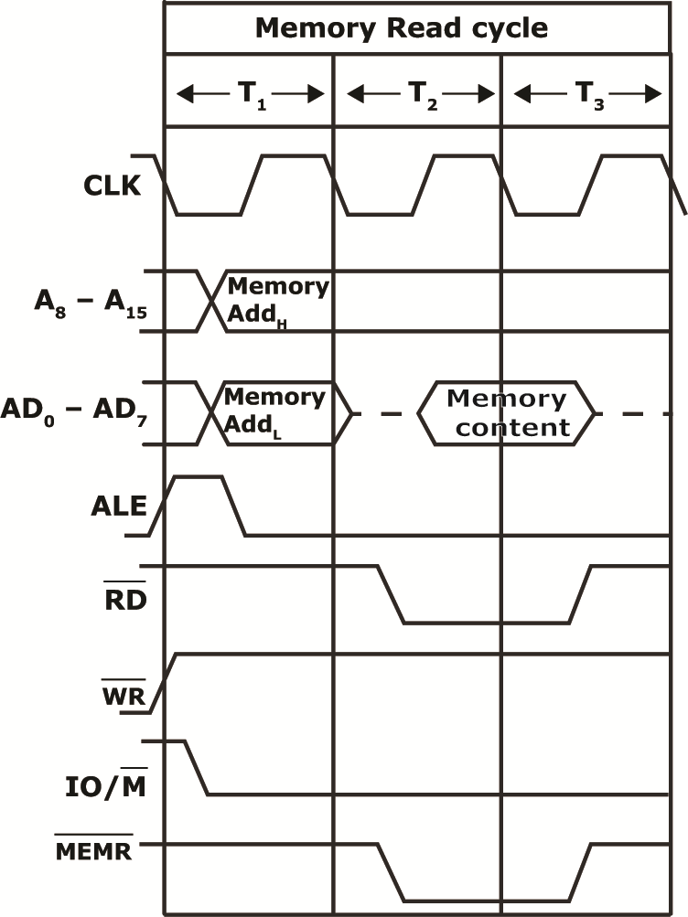
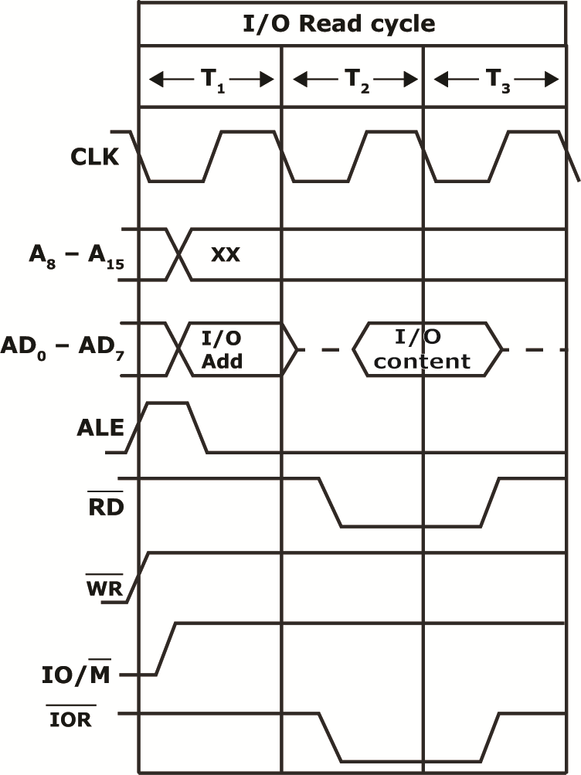
Machine Cycles & Bus Timing Diagrams

Slide 4
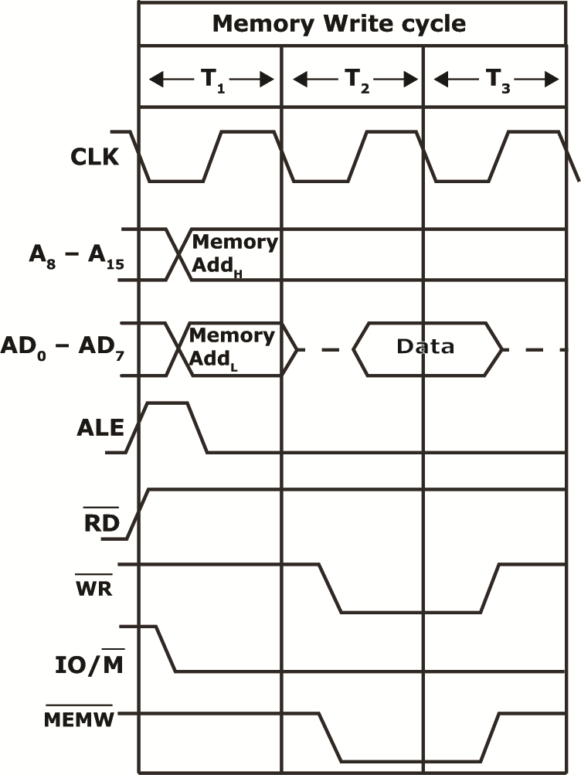
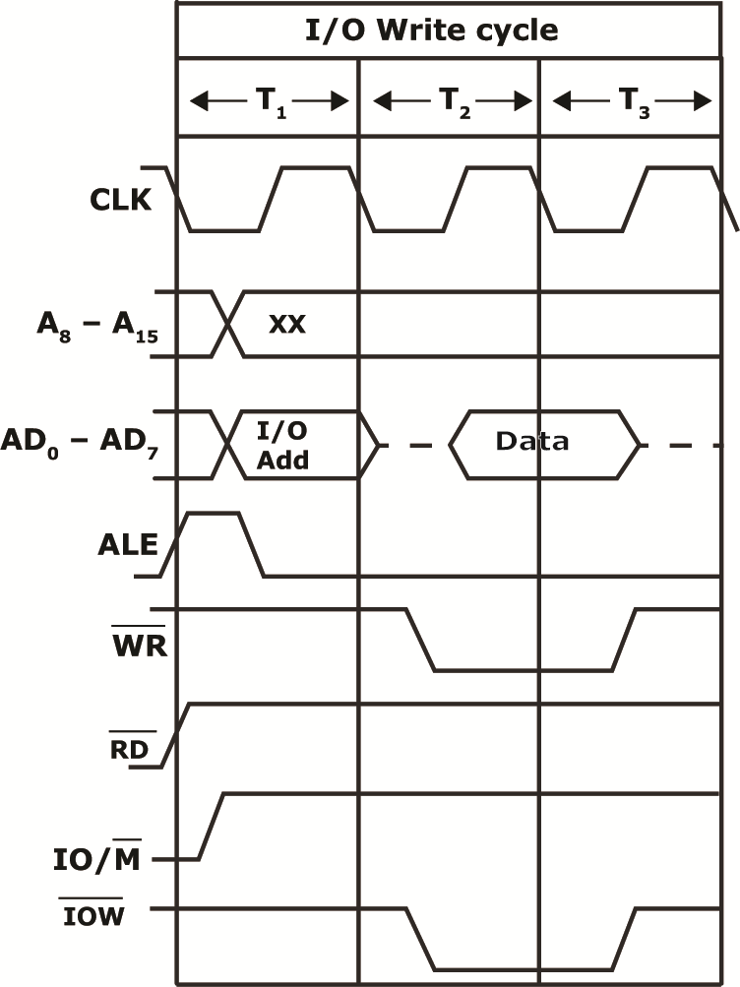
Machine Cycles & Bus Timing Diagrams

Slide 5
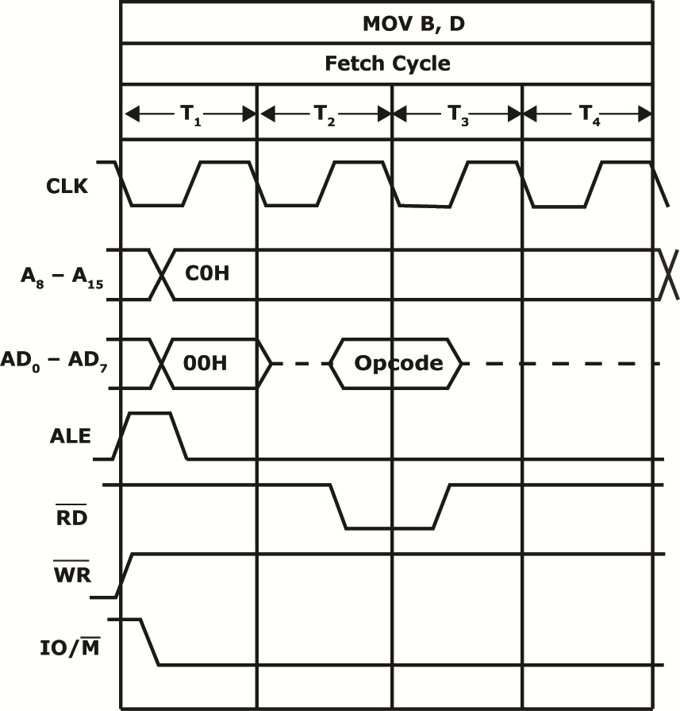
Machine Cycles & Bus Timing Diagrams

Slide 6
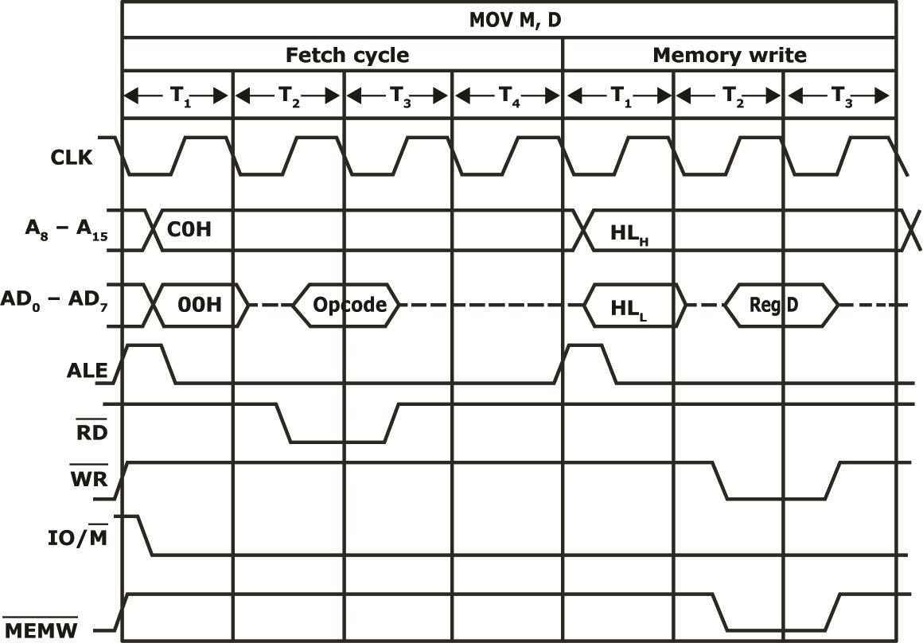
Machine Cycles & Bus Timing Diagrams

Slide 7
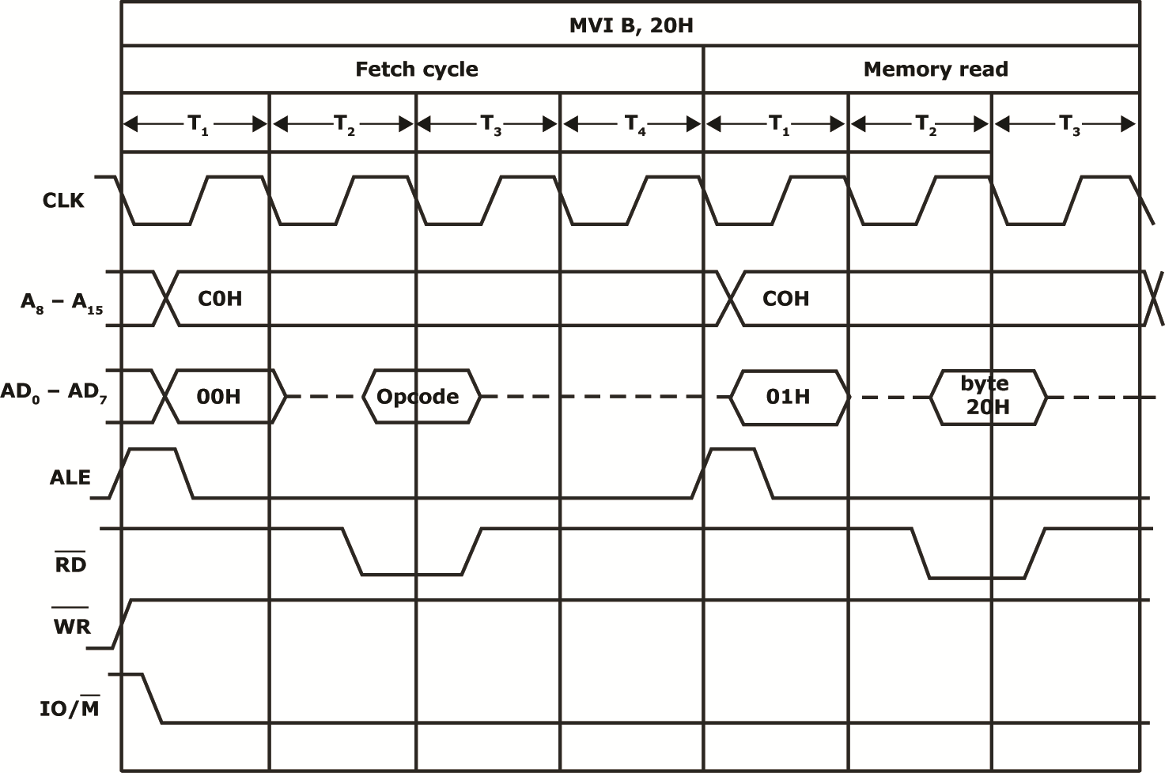
Machine Cycles & Bus Timing Diagrams

Slide 8
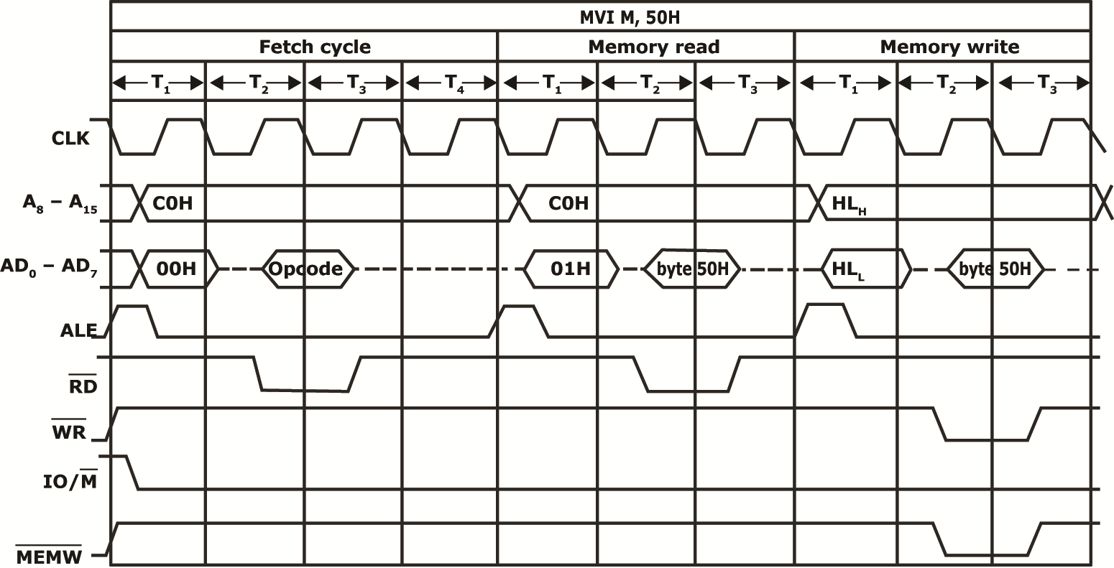
Machine Cycles & Bus Timing Diagrams

Slide 9
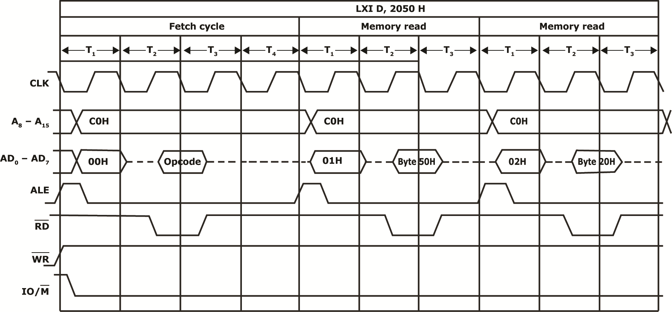
Machine Cycles & Bus Timing Diagrams

Slide 10
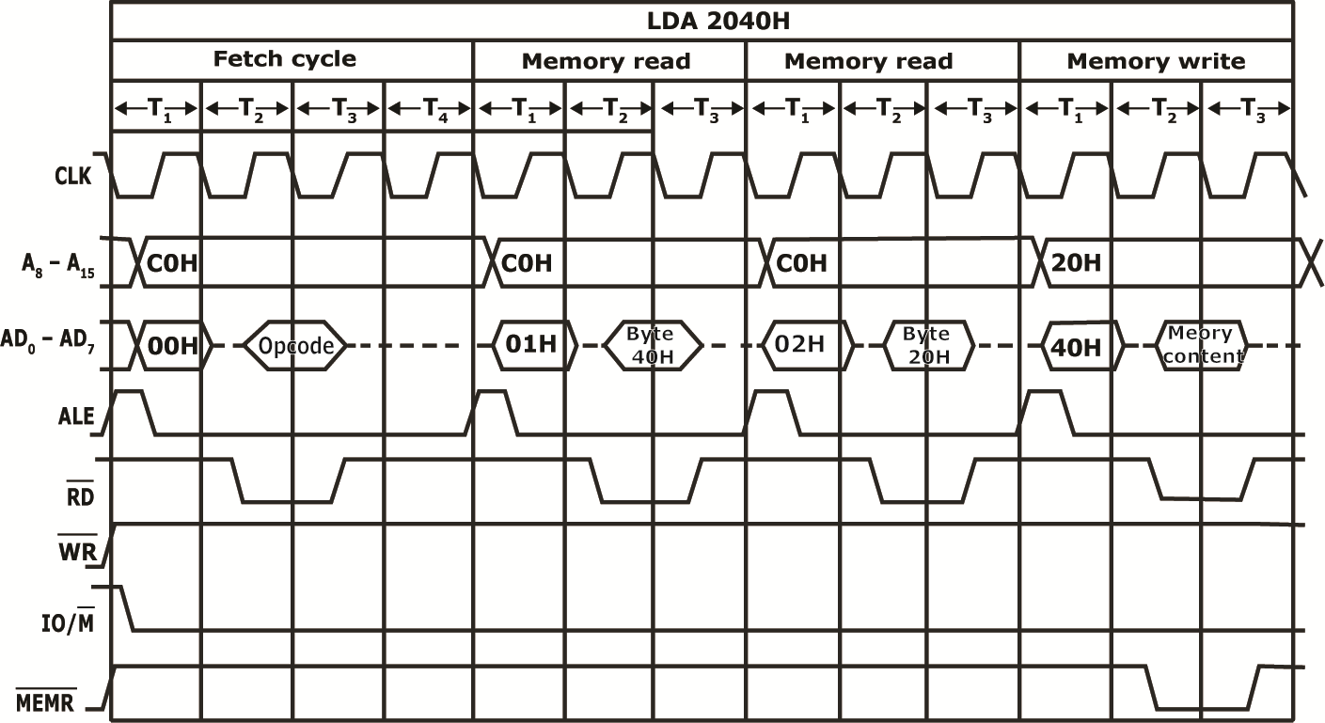
Machine Cycles & Bus Timing Diagrams

Slide 11
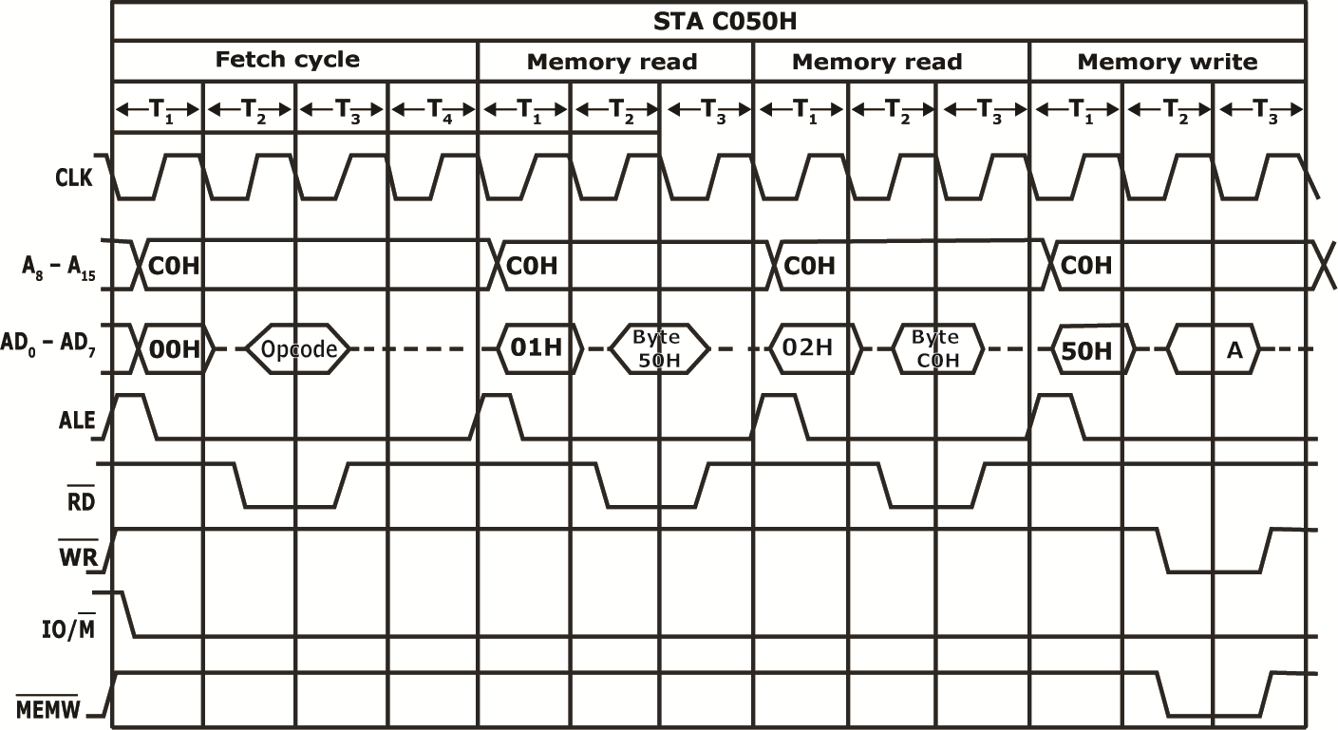
Machine Cycles & Bus Timing Diagrams

Slide 12
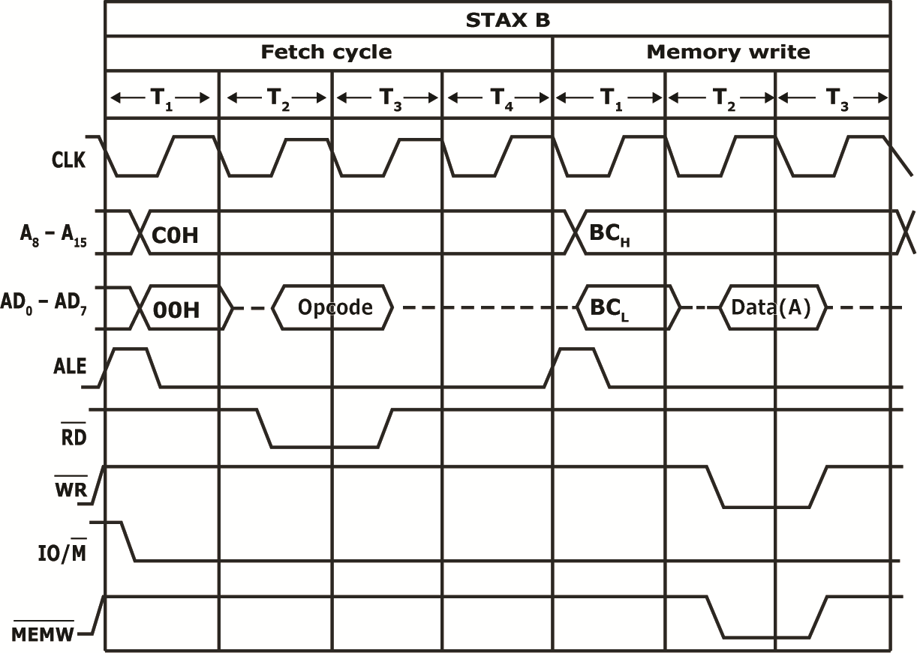
Machine Cycles & Bus Timing Diagrams

Slide 13
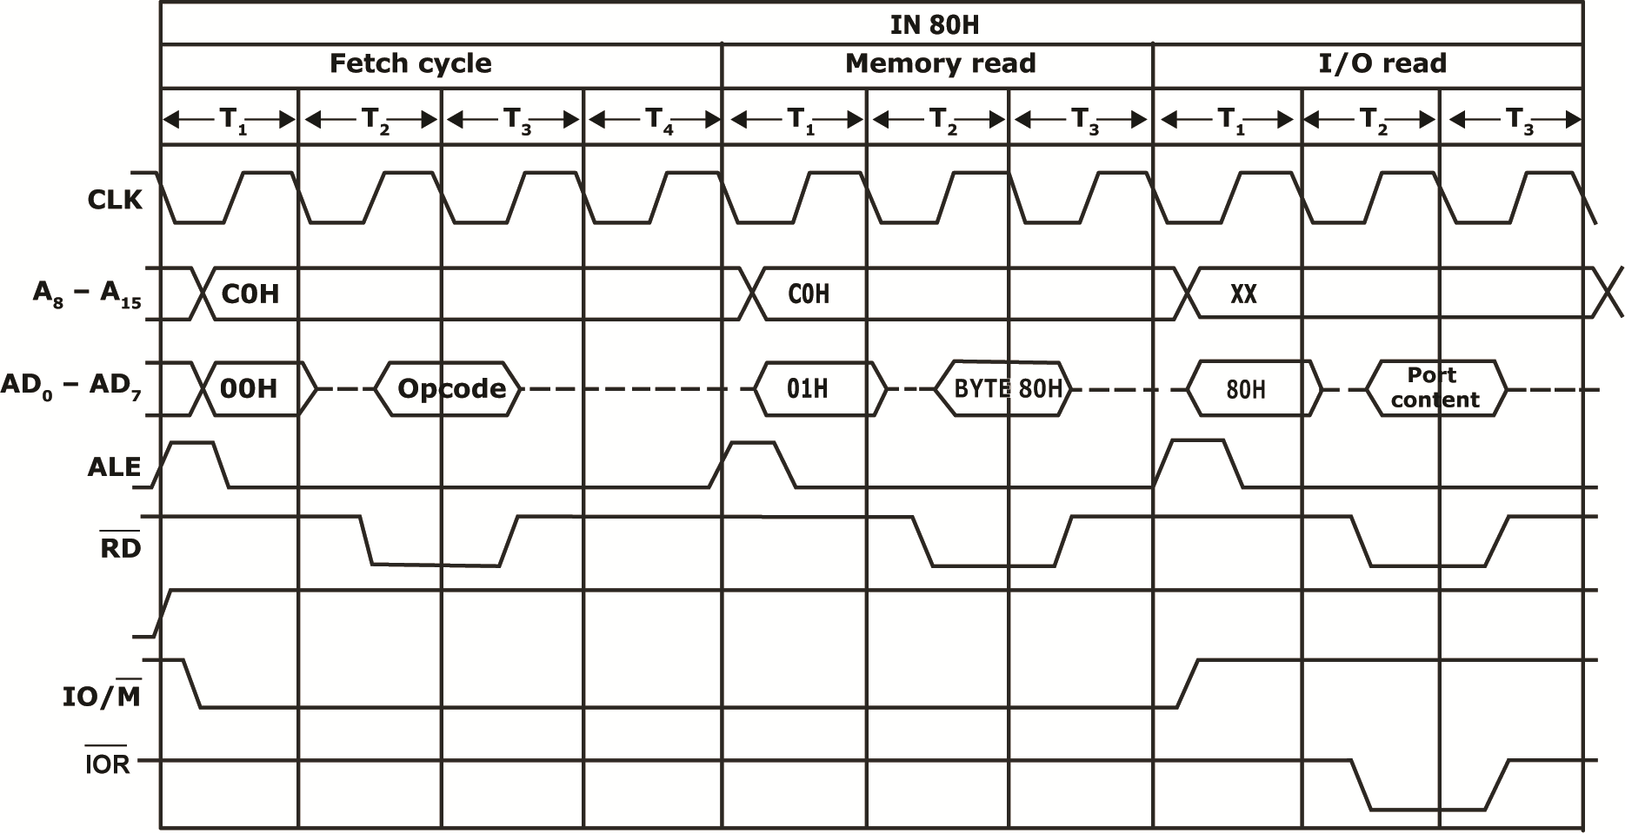
Machine Cycles & Bus Timing Diagrams

Slide 14
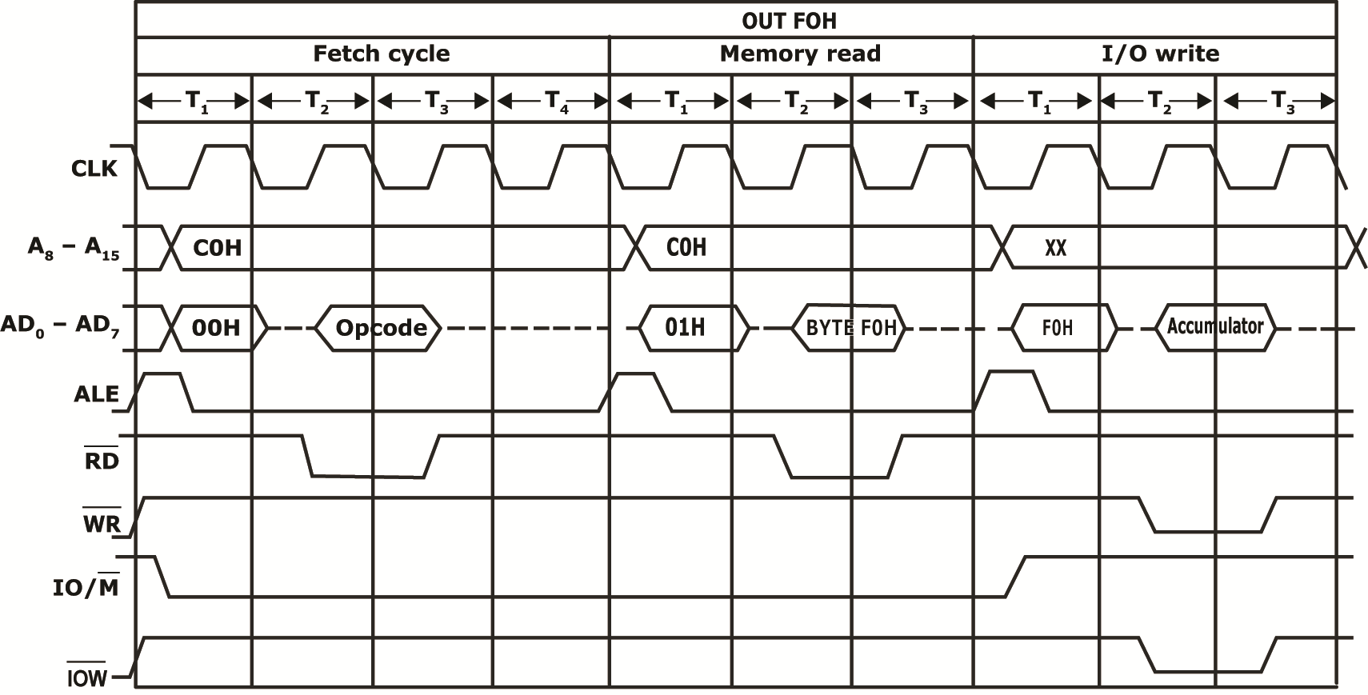
Machine Cycles & Bus Timing Diagrams

